Slide 1

Python Project
Presentation by:
Garvit Choudhary
Team – 13

Slide 2


Index
o1.
Introduction
o2.
About the Project
o3.
Block of codes
o4.
Final Code and Output
o5.
Summary

Slide 3
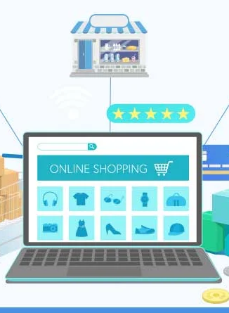
Introduction
The Store Management System is a Python-based application designed to streamline the operations of a retail store. It provides functionalities for managing inventory, processing sales, and enhancing the overall customer experience. The primary objective of our Store Management System is to provide a centralized platform that empowers store owners to effectively manage various aspects of their business, including inventory, sales, and customer interactions. By leveraging technology, we aim to optimize processes, enhance productivity, and ultimately improve the overall shopping experience for customers.

Slide 4

About the Project
The ‘Stores Management System’ is targeted to automate the almost all of the processes mentioned above to reduce the clerical labor of the staff working in Stores both technical and as well as Accounts departments using the software Industry’s latest technologies and cost effective tools there by providing the better control to the management by avoiding manual errors etc..,

Slide 5
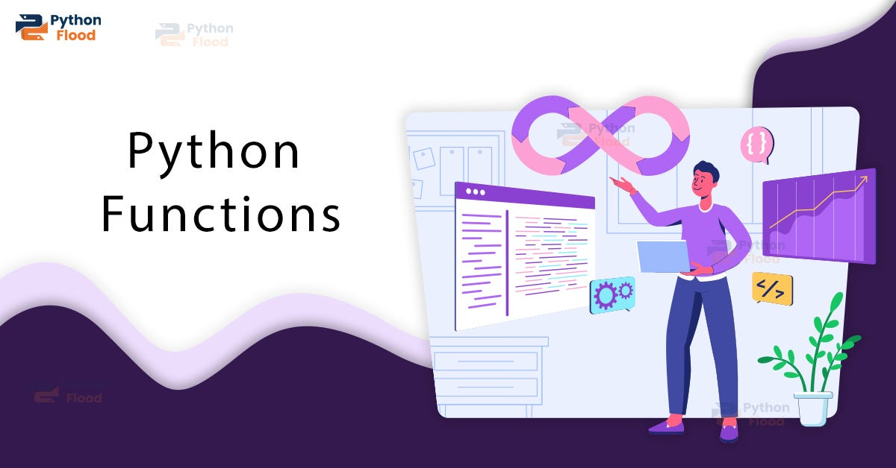
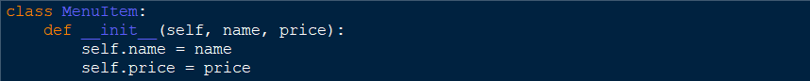
Block of Codes
class MenuItem:
This is a class definition for creating instances of menu items.
It has an __init__ method, which is a constructor used to initialize new MenuItem objects with a name and price.

Slide 6

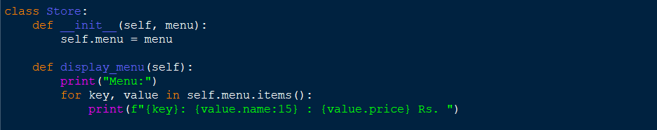
Block of Codes
class Store:
This is a class definition for creating a Store object.
It has an __init__ method, which takes a dictionary menu as an argument and assigns it to the menu attribute of the Store object.
It also has a display_menu method, which prints out the menu items along with their names and prices.

Slide 7
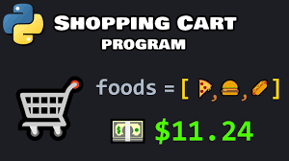
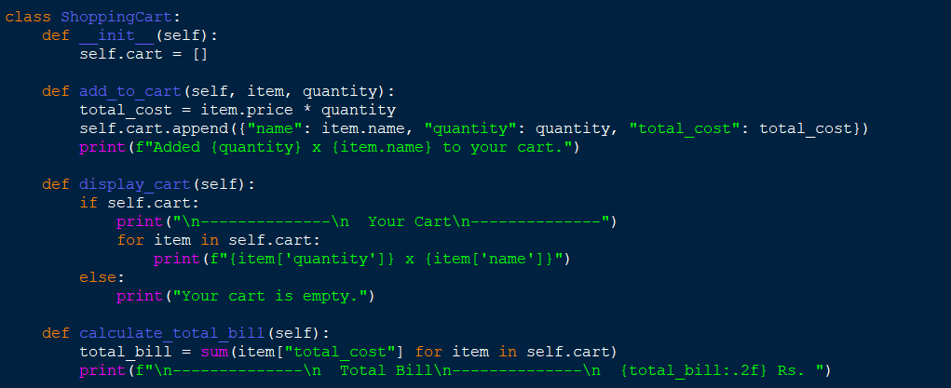
Block of Codes
class ShoppingCart:
This is a class definition for creating a ShoppingCart object.
It has an __init__ method, which initializes an empty list cart to store items added to the shopping cart.
It has three methods:
add_to_cart: Takes an item and a quantity as arguments, calculates the total cost of the items, adds them to the cart, and prints a confirmation message.
display_cart: Prints the contents of the cart, including the quantity, name, and total cost of each item.
calculate_total_bill: Calculates the total bill by summing up the total cost of all items in the cart and prints it.

Slide 8
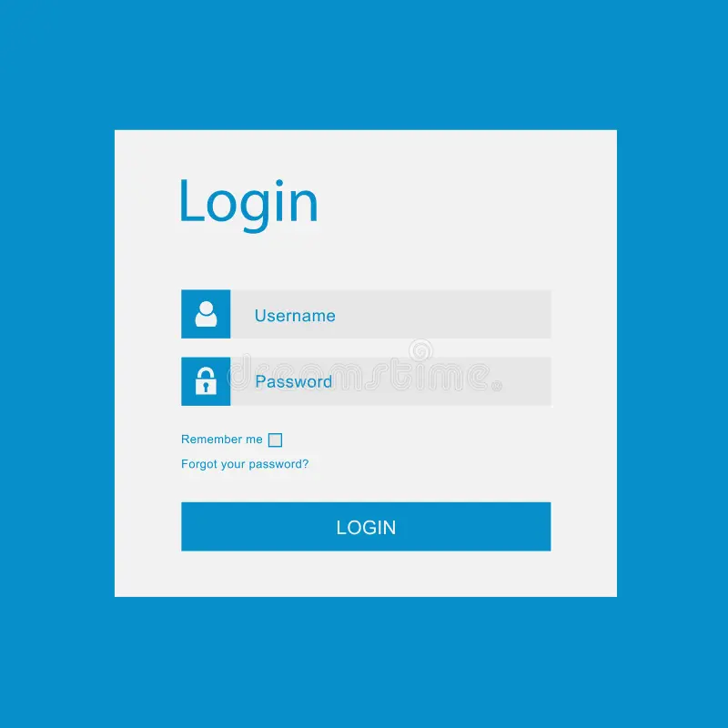
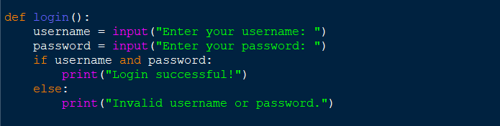
Block of Codes
login():
This is a function definition for handling user authentication.
It prompts the user to enter a username and password.
If both username and password are provided (i.e., they are not empty strings), it prints "Login successful!". Otherwise, it prints "Invalid username or password."

Slide 9
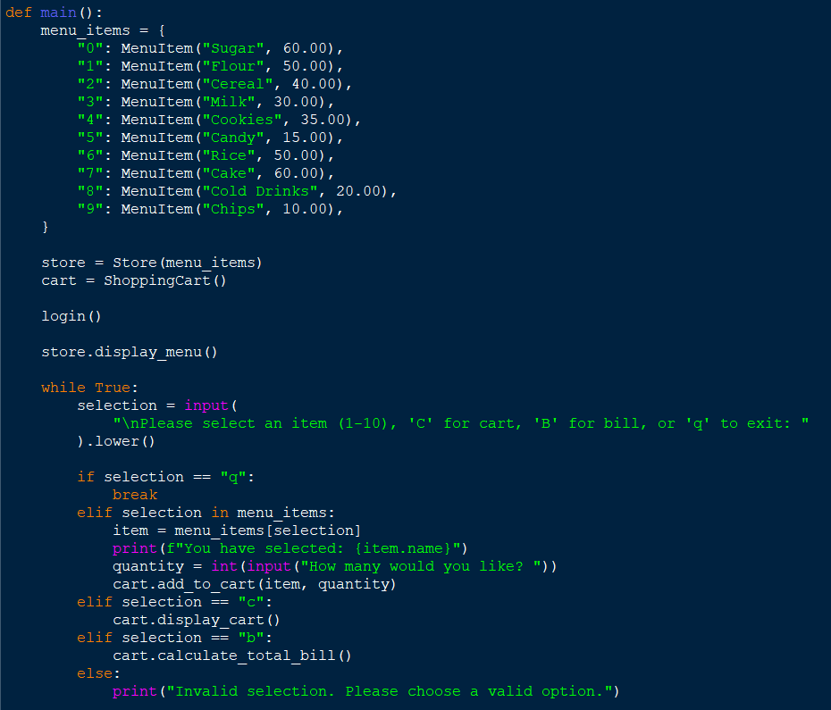
Block of Codes
main():
This is the main function where the program execution starts.
It creates a dictionary menu_items containing MenuItem objects representing different items in the store's menu.
It creates instances of Store and ShoppingCart classes.
It calls the login() function for user authentication.
It calls the display_menu() method of the Store object to display the menu.
It enters a loop where it prompts the user to select items, view the cart, view the total bill, or exit the program based on user input.
Depending on the user input, it adds items to the cart, displays the cart contents, calculates the total bill, or exits the loop to end the program execution.

Slide 10
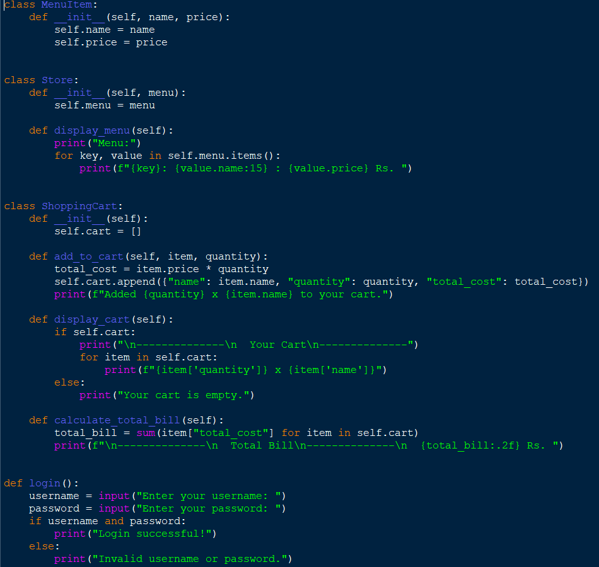
Final Code

Slide 11
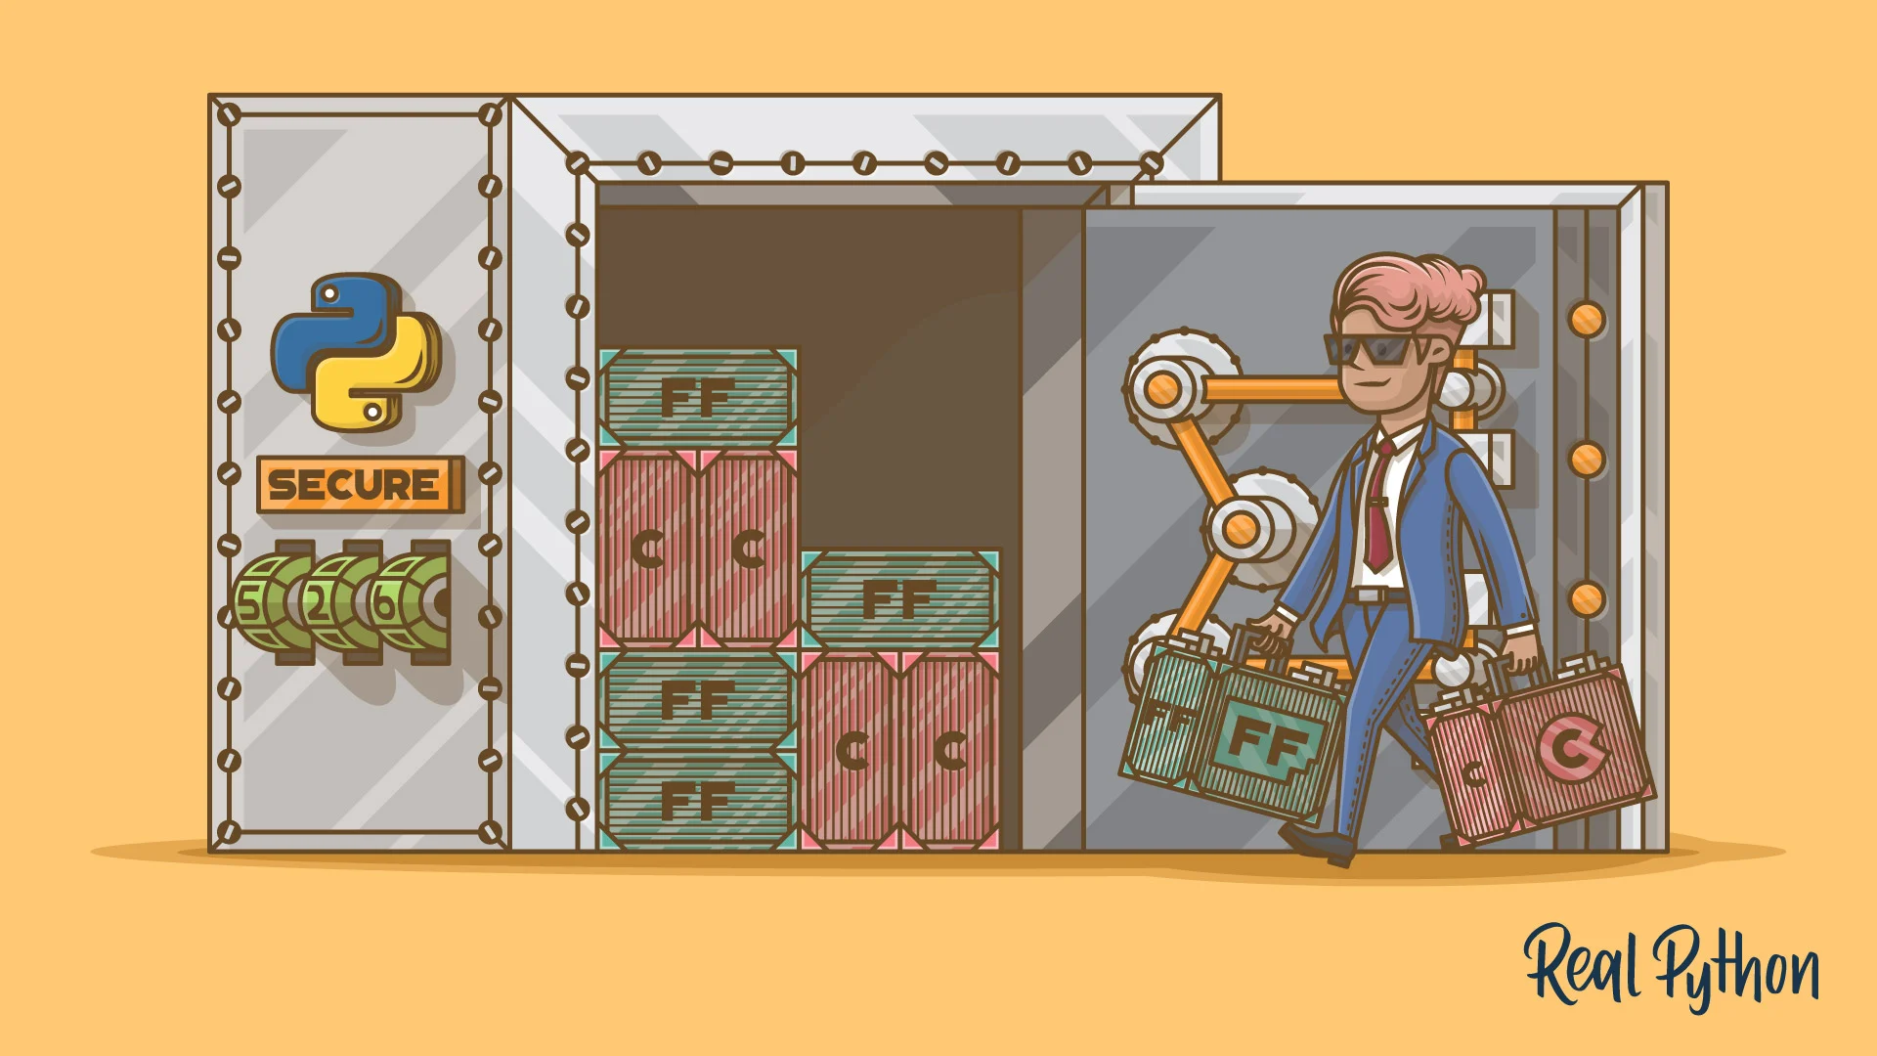
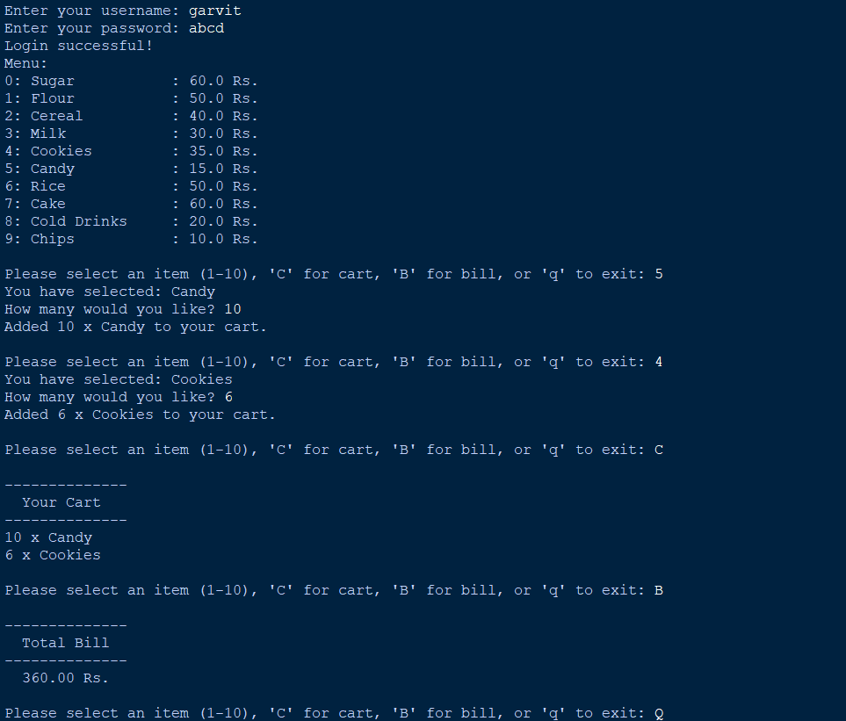
Final Output

Slide 12

Summary
What we’ve learned so far
Store Management System
The project is a simple implementation of a store management system in Python.
It allows users to view a menu of items available in the store, add items to a shopping cart, and calculate the total bill.
OOPS
The project adopts an object-oriented approach, with classes defined for MenuItem, Store, and ShoppingCart.
These classes encapsulate related functionality and promote code organization and reusability.
User Interaction
Users interact with the system through a command-line interface (CLI).
They can log in with a username and password (basic authentication), view the menu, add items to their shopping cart, view the cart contents, and calculate the total bill.

Slide 13

Thank you
Batch -12 Garvit Choudhary R2142230353 500119455
Team - 13

